Slide 1
Planning for Information System
Chapter - 5
Kantipur Engineering College
Dhapakhel, Lalitpur

Slide 2
What is Information System Planning
Information system planning is a formal process that develops plan for developing and managing information systems that will support goals of an organization.
Information System plan includes:
Activities planner believes will help achieve goals.
Program for monitoring real-world progress.
Means for implementing changes in the plan.
Notes:
Management Information Systems (MIS) is the key factor to facilitate and attain efficient decision making in an organization

Slide 3
Why Plan?
To obtain resources
Financial
Facilities – “Capacity planning”
Staff
To align Information System with the business
To identify needed applications
To establish goal, schedule, and milestone in order to track progress
To provide an opportunity for communication with top management and user management

Slide 4
Approaches to Planning
Top-down Planning
Focuses on organizational goals first, then on the needs of business units
Bottom-up Planning
Focuses on needs of business units first, then on organizational goals

Slide 5
Information System Planning Process
Establish a mission statement
Assess the environment
Set goals and objectives
Derive strategies and policies
Develop long-, medium-, and short-range plans implement plans and monitor results

Slide 6
Establish a Mission Statement
These are services that you are responsible for; it is your place in the organization.
It is not what you are supposed to achieve, it is who you are and what you do in the company.

Slide 7
Goals and Objectives
Set goals – what do you want to achieve?
Set objectives – what are your specific, measurable targets?

Slide 8
Derive strategies and policies
Strategies for
Technology focus
Personnel and career development
Aligning with the company
Funding criteria; how much to spend on IT?
Policies for
Funding criteria; how much to spend on IT?
Allocation criteria; priority setting
Organizational arrangements
Use of outside IT services, outsourcing
Selling IT services to outside organizations

Slide 9
Develop long-, medium-, and short-range plans
Short-Range – the next year, the next budget period; developing and operating current systems
Medium-Range – committing to development efforts for applications that will take more than one year to complete; meeting management’s current information needs, projected into the future for as many years as needed to complete them. This is what most organizations call “Long-Range Planning.”
Long-Range planning – preparing for management’s future information needs. These are not application specific; they are investments in infrastructure ; it is creating an information architecture.

Slide 10
What are Key Elements of IS Planning
Key elements of an IS Plan are
Corporate mission statement
Vision for IT within organization
IS strategic and tactical plans
Operations plan to achieve mission and vision
Budget to ensure resources are available

Slide 11
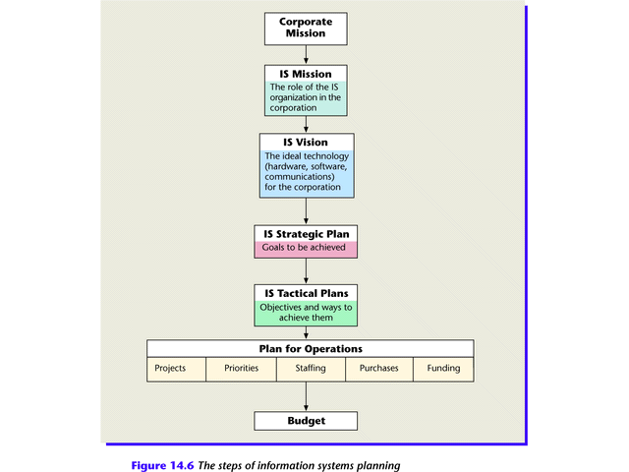
Steps of Information Systems Planning

Slide 12
Information Systems Planning
The Corporate and IS Mission Statements
The corporate mission statement details the purpose of the organization and its overall goals.
IS mission statement outlines the purpose of ISs in the organization.

Slide 13
Information Systems Planning
The IT Vision
Wish list of what IS managers would like to see in terms of hardware, software, and communications, to contribute to goals of the organization

Slide 14
Information Systems Planning
Strategic IS Planning
IS Strategic plan details what is to be achieved
Strategic plans are designed with the entire organization in mind and begin with an organization's mission.
Essentially, strategic plans look ahead to where the organization wants to be in three, five, even ten years. Strategic plans, provided by top-level managers, serve as the framework for lower-level planning.
Notes:
Strategic Management: Carried out by top corporate executives and corporate boards responsible for setting and monitoring long-term directions for the firm for three or more years into the future.

Slide 15
Strategic Information System
Strategic Information System is a system that helps companies alter their business strategy. It is used to accelerate the reaction time to environmental changes and aid the company in achieving a competitive advantage over its competitors.
They help in producing low cost quality products.
The strategic role of IS involves using IT to develop products, services, and capabilities that give company major advantages over the competitive forces it faces in the global marketplace.
Notes:
Strategies should be kept simple when possible.
The goal for Information System is to help business strategies succeed.
Information Systems are never a strategy alone.

Slide 16
Typical Strategic-Level Job Titles
Top-level Managers
CEOs or Presidents
General Manager
Corporate Boards
Steering Committee
Board of Directors
will design and execute strategic plans to paint a picture of the desired future and long-term goals of the organization.

Slide 17
Tactical IS Planning
IS Tactical plan describes how goals will be met and by when
Tactical IS Plan performed by middle managers responsible for acquisition and allocation of resources for projects according to tactical plans, set out for one or two years.
Tactical IS Planning is evaluates current and projected information needs of the organization, prioritizes IS development projects, and develops allocation plans for financial and technology resources.

Slide 18
What are important factors in IS tactical planning
Important Factors in IS Tactical Planning
Flexibility
Compatibility
Connectivity
Scalability
Standardization
Total Cost of Ownership

Slide 19
Typical Tactical-Level Job Titles
Advertising manager
Personnel manager
Creative director
Manager of information systems
Communications director
Chief Financial Officer

Slide 20
Operational IS Planning
Operational Plan prepared by a component of an organization that clearly defines actions it will take to support the strategic objectives and plans of upper management.
Operational IS Planning develops plans such as annual operating budgets and individual IS project plans.
Operations IS Planning performed by supervisors of smaller work units concerned with planning and control of short-term (typically, a week or six months) budgets and schedules.
Notes:
First, it assumes that upper management has prepared both a Strategic Plan and a Tactical Plan. This means that lower management should have a clear sense of what they are trying to achieve. They just have to come up with a detailed plan to make it happen! Second, the Operational Plan is limited to only one part of the organization. For example, a large corporation (Strategic Plan) has a manufacturing division (Tactical Plan) that produces products A, B, and C. Each product is manufactured in a separate plant run by a plant manager who prepares a separate Operational Plan. Operational Plans can be subdivided into two categories. Single-use plans address only the current period or a specific problem. An example would be a plan to cut costs during the next year. Ongoing plans carry forward to future periods and are changed as necessary. An example would be a long-term plan to retrain workers instead of layoffs.

Slide 21
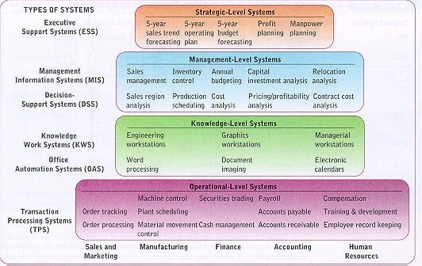
Hierarchy of Planning
Notes:
A good planning process helps organizations learn about themselves, uses resources efficiently and effectively, and promotes organizational change and renewal.

Slide 22
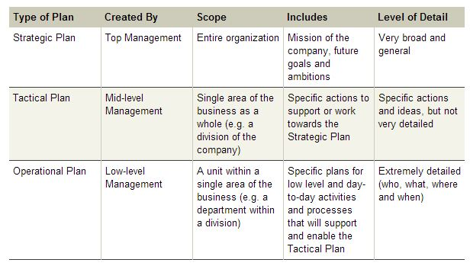
Three levels of planning.

Slide 23
Thank You

